Slide 1
KPI DASHBOARD FOR HOSPITALITY DOMAIN

Slide 2
Business Objective
AtliQ is a company that owns multiple hotel chains across various cities of India.
The managing director of AtliQ Grands wanted to incorporate “Business and Data Intelligence” to regain their market share and revenue.
Hence, it is decided to develop a KPI Dashboard for AtliQ, using May-22 to July-22 data, which can help track its revenue sources and other relevant KPIs across various dimensions

Slide 3
Problem Statement
Clean and model the data as per requirement for analysis
Create a revenue dashboard that measures important KPIs
Relevant filters need to provided to slice and dice the data
The dashboard should depict both high level and granular insights

Slide 4
Solution Approach
There are 5 tables provided for tracking revenue, 3 dimension tables (date, hotel, room) and 2 fact tables (bookings, aggregated bookings)
Power BI was the tool used for creating the visualization/dashboard
The data was imported, analysed and transformed as per necessity within Power Query

Slide 5
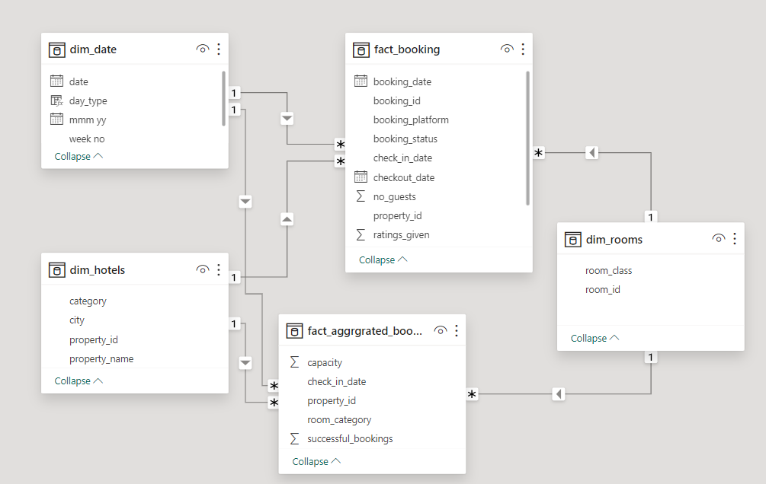
Data Modelling

Slide 6
Solution Approach
A few Measures were created to calculate the KPIs as shown below :
Revenue – Sum of realized revenue from Booking table
RevPar – Revenue per available room from Booking table
DSRN – Daily Sellable room night from Booking and date table
Occupancy % - Total successful booking happens to the total room available from Booking table

Slide 7
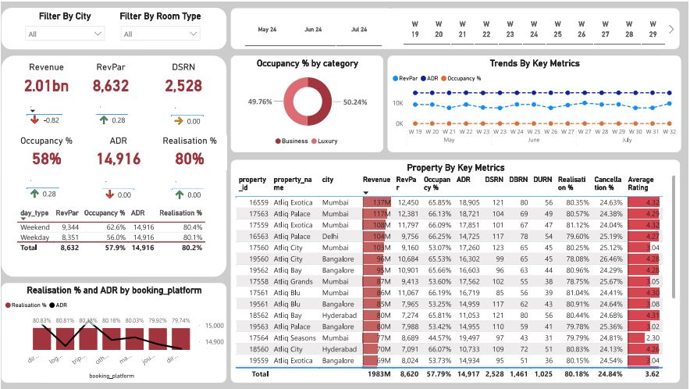
Revenue Dashboard

Slide 8
Features Of The Dashboard
The following visuals were provided :
Trend by key metrics – Line chart comparing RevPar , ADR and Occupancy %
Occupancy % by Category – Pie chart representing the proportion of total occupancy distributed among business and luxury category (in %).
Realisation % and ADR – Line and column stacked chart for comparing Realisation % and Average Daily Revenue by booking platform.

Slide 9
Features Of The Dashboard
Six Card visuals were provided to show the important KPIs.
The following slicers were provided to filter the data:
By City
By Room Type
By Year
By Week
Tooltips pop-up when hovering over a visual for more information about the data point

Slide 10
Business Outcomes
Mumbai generates highest revenue and Delhi generates least revenue during May to Jul.
Occupancy rate is higher during weekend whereas the Average Daily Revenue remains almost same during weekend and weekdays. Adjusting prices during could help maximize revenue during peak occupancy periods.
Direct offline leads in Average daily revenue while achieving a high realisation rate whereas direct Online platforms shows the lowest realisation rate.

Slide 11
Business Outcomes
Average rating lies between 3.41 and 3.78 across cities and Average Cancellation rate is in between 24.67% and 25.03%.
Mumbai excel across all metrics (DSRN, DBRN, DURN) suggesting it has the highest capacity, booking performance and utilization rates whereas Delhi has the lowest values in all metrics.

Slide 12

Conclusion
01
A revenue dashboard was build for AtilQ hotels depicting its various KPIs visually
02
Relevant filters along with tooltip and interactions was provided in the dashboard.
03
This dashboard can be used for both high level and in-depth analysis of KPIs across various dimensions.

Slide 13
Thank You

